Slide 1
MUSIC RECOMMENDATION SYSTEM
Team Name: Alpha G
Team Members:
Phalya Jhamb | 2210990649
Rachit Walia | 2210990695
Raghav Thakur | 2210990701
Pratham Tandon | 2210990676
Priyanshu | 2210990685

Slide 2
Introduction
Music Recommendation system works on the principle of understanding the nuances of each listener's taste, the system can suggest personalized music recommendations that resonate with them.Through this project, we hope to not only enhance the music listening experience but also showcase the power of AI in delivering tailored content to users, ultimately creating a more enjoyable and immersive music discovery journey.

Slide 3
Objective
The objective of creating an AIML (Artificial Intelligence Markup Language) project are :
*Automation:* AIML is used to automate tasks that are repetitive or time-consuming for humans.
2. *Efficiency:* AIML projects are aimed at improving efficiency by streamlining processes, reducing errors, and optimizing resource utilization.

Slide 4
Objective
3. *Innovation:* AIML is used to develop innovative solutions that can improve existing systems or create new opportunities.

Slide 5
Flow of Our Project
The flow of creating an AIML (Artificial Intelligence Markup Language) project typically involves several key steps:
*Define the Problem:* We aim at creating a music recommendation system that is user-friendly and enhances user experience.
*Data Collection:* We Gathered the relevant dataset needed for our project.
*Data Preprocessing:* Clean and preprocess the data to ensure it is in a suitable format for training your AIML model. This may involve tasks such as removing duplicates, handling missing values, and converting data into a format that can be used by your model.

Slide 6
Algorithm
4.*Feature Engineering:* Extract relevant features from your data that can help
improve the performance of your AIML model
5. *Model Selection:* Choose the appropriate AIML model or algorithm for your
project. This will depend on the nature of your problem and the type of data you
are working with.
6. *Deployment*

Slide 7
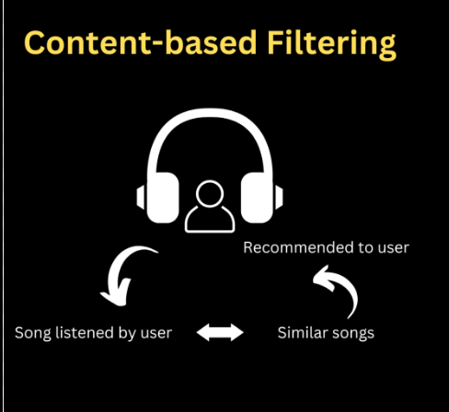
Define the Problem
We aim at creating a music
Recommendation system that gives output which goes through content-based filter to recommend user a song based on the requirement entered as a input by the user.

Slide 8
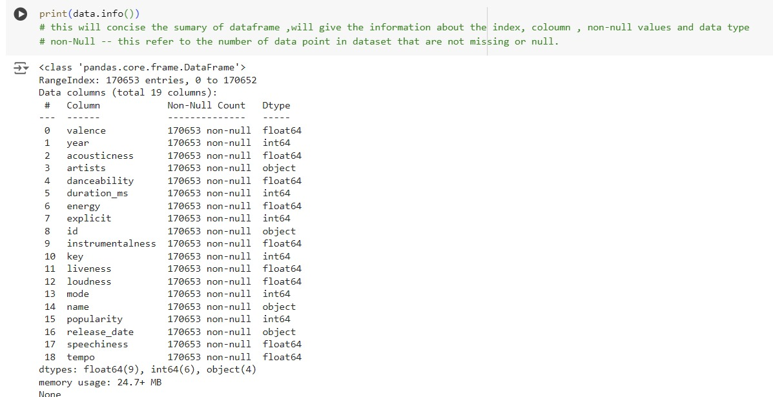
Data Collection
The dataset we chose contains the data which contains all the required fields we need to consider to give the required output.

Slide 9
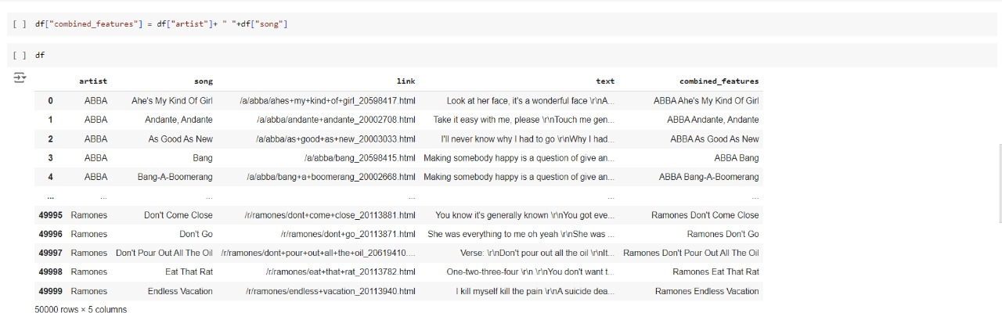
Data Collection
We made a “combined feature” to concatenate all the required labelled categories so that we can implement cleaning in one go.

Slide 10
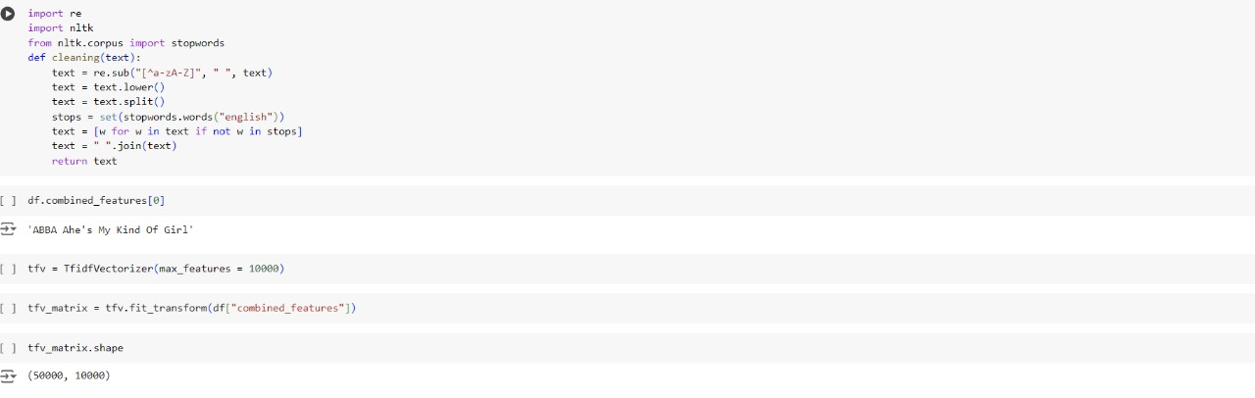
Data Pre-Processing
We implemented cleaning on our dataset which helps to remove non-alphabetic characters, converting text to lowercase and then print the cleaned text.

Slide 11
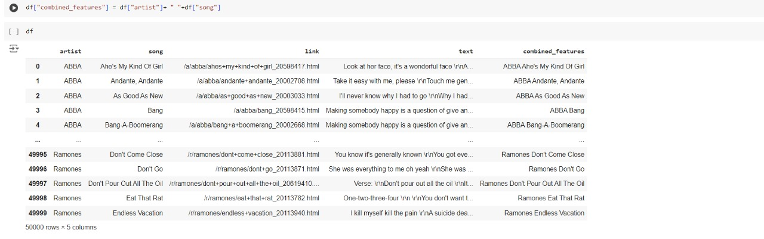
Feature Engineering
The combined feature function gives us the artist name, song name and lyrics of the song that has been recommended based on the keyword given by the user.

Slide 12
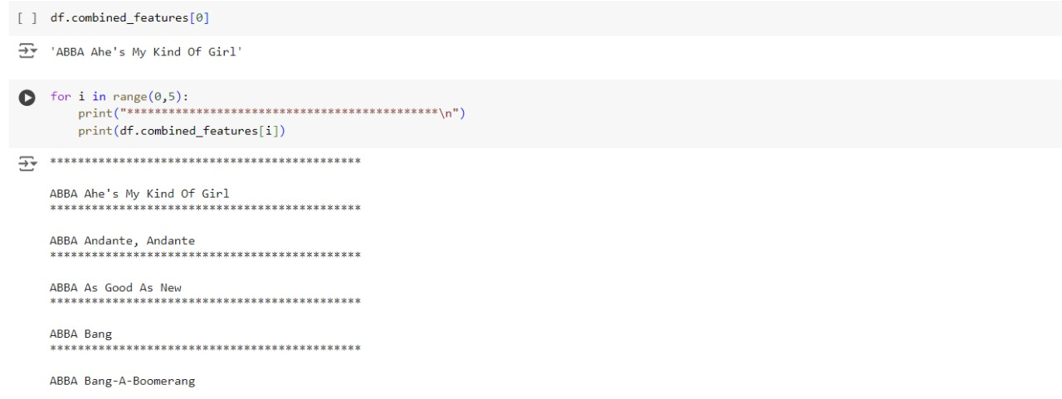
Model Selection
We used Cross-Validation.
In cross-validation we iterate the program with subsets of the dataset and evaluate the model multiple times. We took a set of 5 inputs at once.

Slide 13
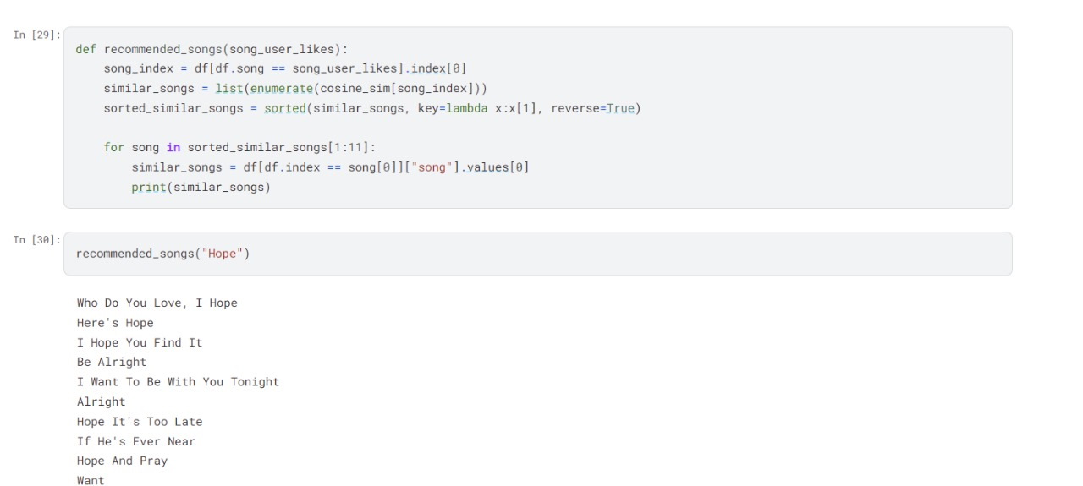
Deployment
On final Deployment, we got the following result:

Slide 14
Conclusion
The music recommendation system project successfully implemented a content-based recommendation system
.Key steps in the project included:
Cleaning the data by removing non-alphabetic characters, converting text to lowercase, and removing stopwords.
Feature extraction: Using TF-IDF vectorization to convert text data into numerical features.Similarity calculation: Using cosine similarity to calculate the similarity between songs based on their lyrics and metadata.
Recommendation: Recommending similar songs to the user-selected song based on the computed similarities.
Future improvements could include incorporating user feedback to enhance the recommendation process further.

